Slide 1


YOUR LOGO
CISC3003 Work Report
Campus Q&A
TEAM 04
PAIR 06 | Huang Yanzhen | DC126732
 | Li Ruoxuan | DC027534
PAIR 04 | Chen Zirui | DC127901
 | Guo Pengze | DC127461
PAIR 24 | Chen Pengyu | DC125135
 | Lei Chon Hin | DC026736
Web programming

Slide 2
PART 01
Introduction

Slide 3
Introduction
In the University of Macau, there has never been a unified school forum.
Therefore, we hope to develop a student forum software, so that
Everyone can freely raise and discuss their questions in study and life and
Get answers from enthusiastic students.
Function：Campus Q&A is a platform that allows students on campus to ask and answer questions. A student can post a public question for all students to answer, and a student can answer a public question by replying to the corresponding public post.
Target User：Campus students
Technologies： Front-end: HTML + CSS + JS Back-end: PHP + MySQL

Slide 4
Introduction / List of Services
Service | Supplement
Post a Question
Close / Re-Open a Question | As soon as a question is considered solved by the asker and the asker no longer expect any answers, he or she could close the question. Users could still reply to closed questions.
Reply to a Question
Sign up / Delete an Account
Login / Log out an Account
Alter a user name and email
Change User Password

Slide 5
Introduction / List of Tasks
Service | Work Distribution
Project Coordination | PAIR 06, PAIR 04, PAIR 24
Version Control | PAIR 06, PAIR 04, PAIR 24
Front-end Design & Implementation | PAIR 06, PAIR 04, PAIR 24
Backend Design & Implementation | PAIR 06, PAIR 04, PAIR 24
Digital Story Scripting | PAIR 06, PAIR 24

Slide 6
PART 02
System Design

Slide 7
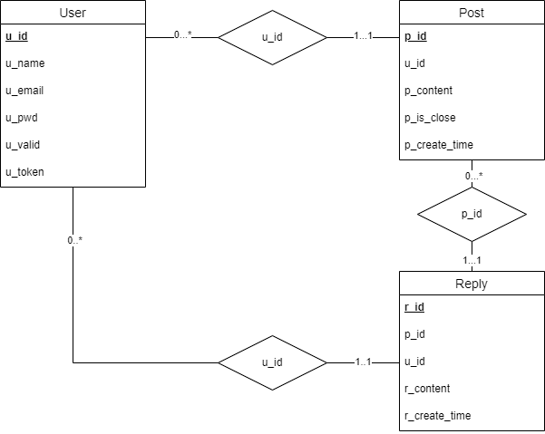
System Design / Database Design

Slide 8
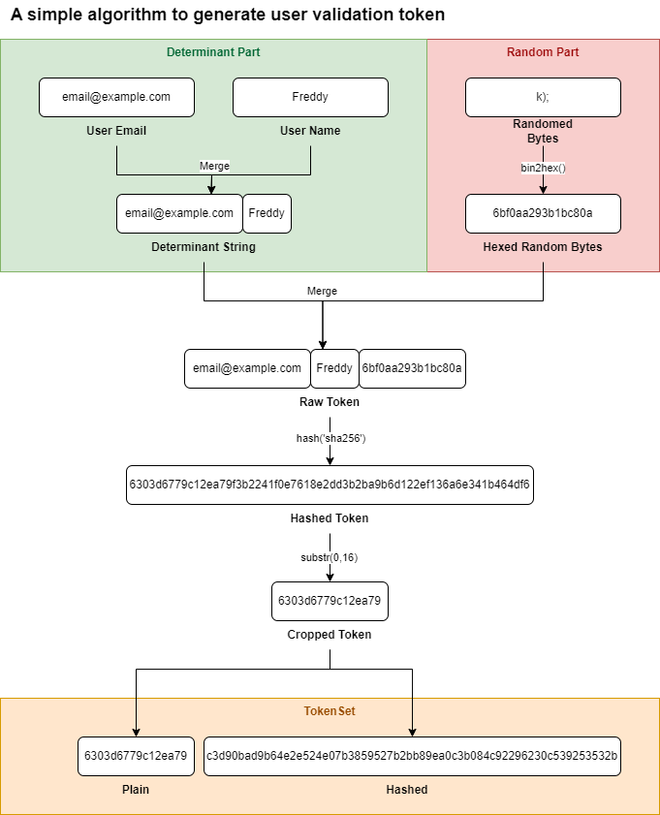
System Design / Tokens
Token validation is used to verify user’s integrity.
Anytime a verification is needed, a new user token will be generated and sent to the user’s email account.
Randomization: Random 8 bytes.
TokenSet:
Plain: Plain token to be sent to user email.
Hashed: To store in the database.

Slide 9
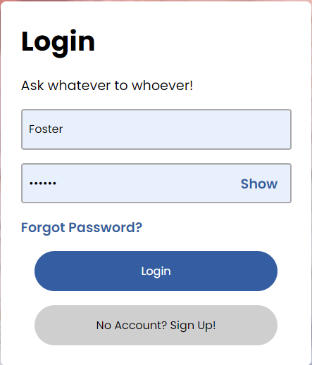
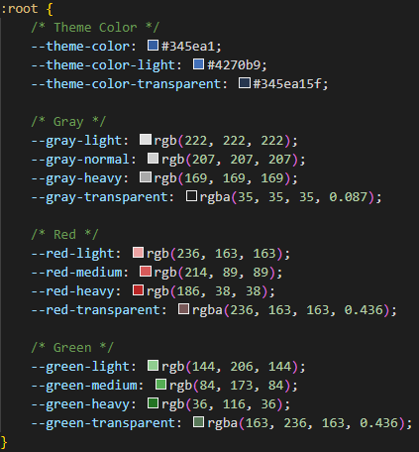
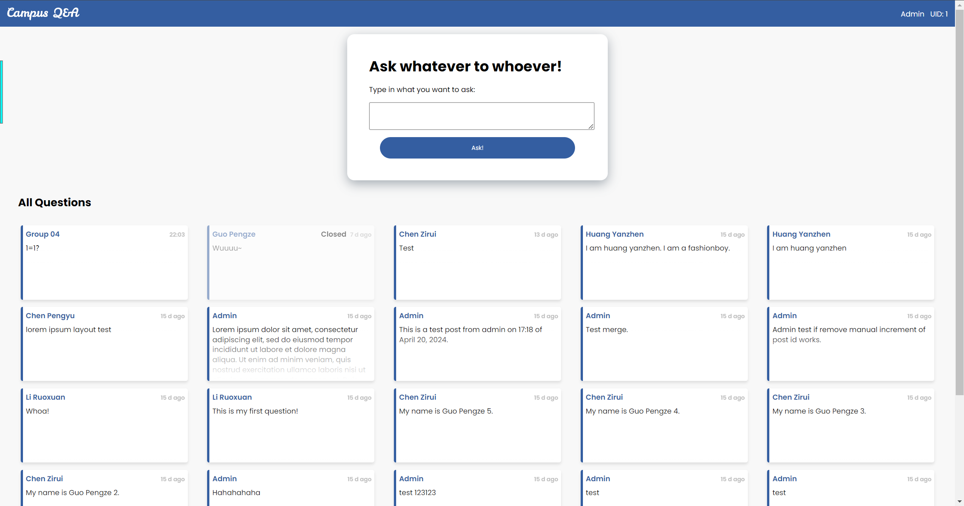
System Design / User Interface
Design Language:
Unified Color Set and Variances
Unified Button Styles
Card View
Google Poppins Font
Responsive Design

Slide 10
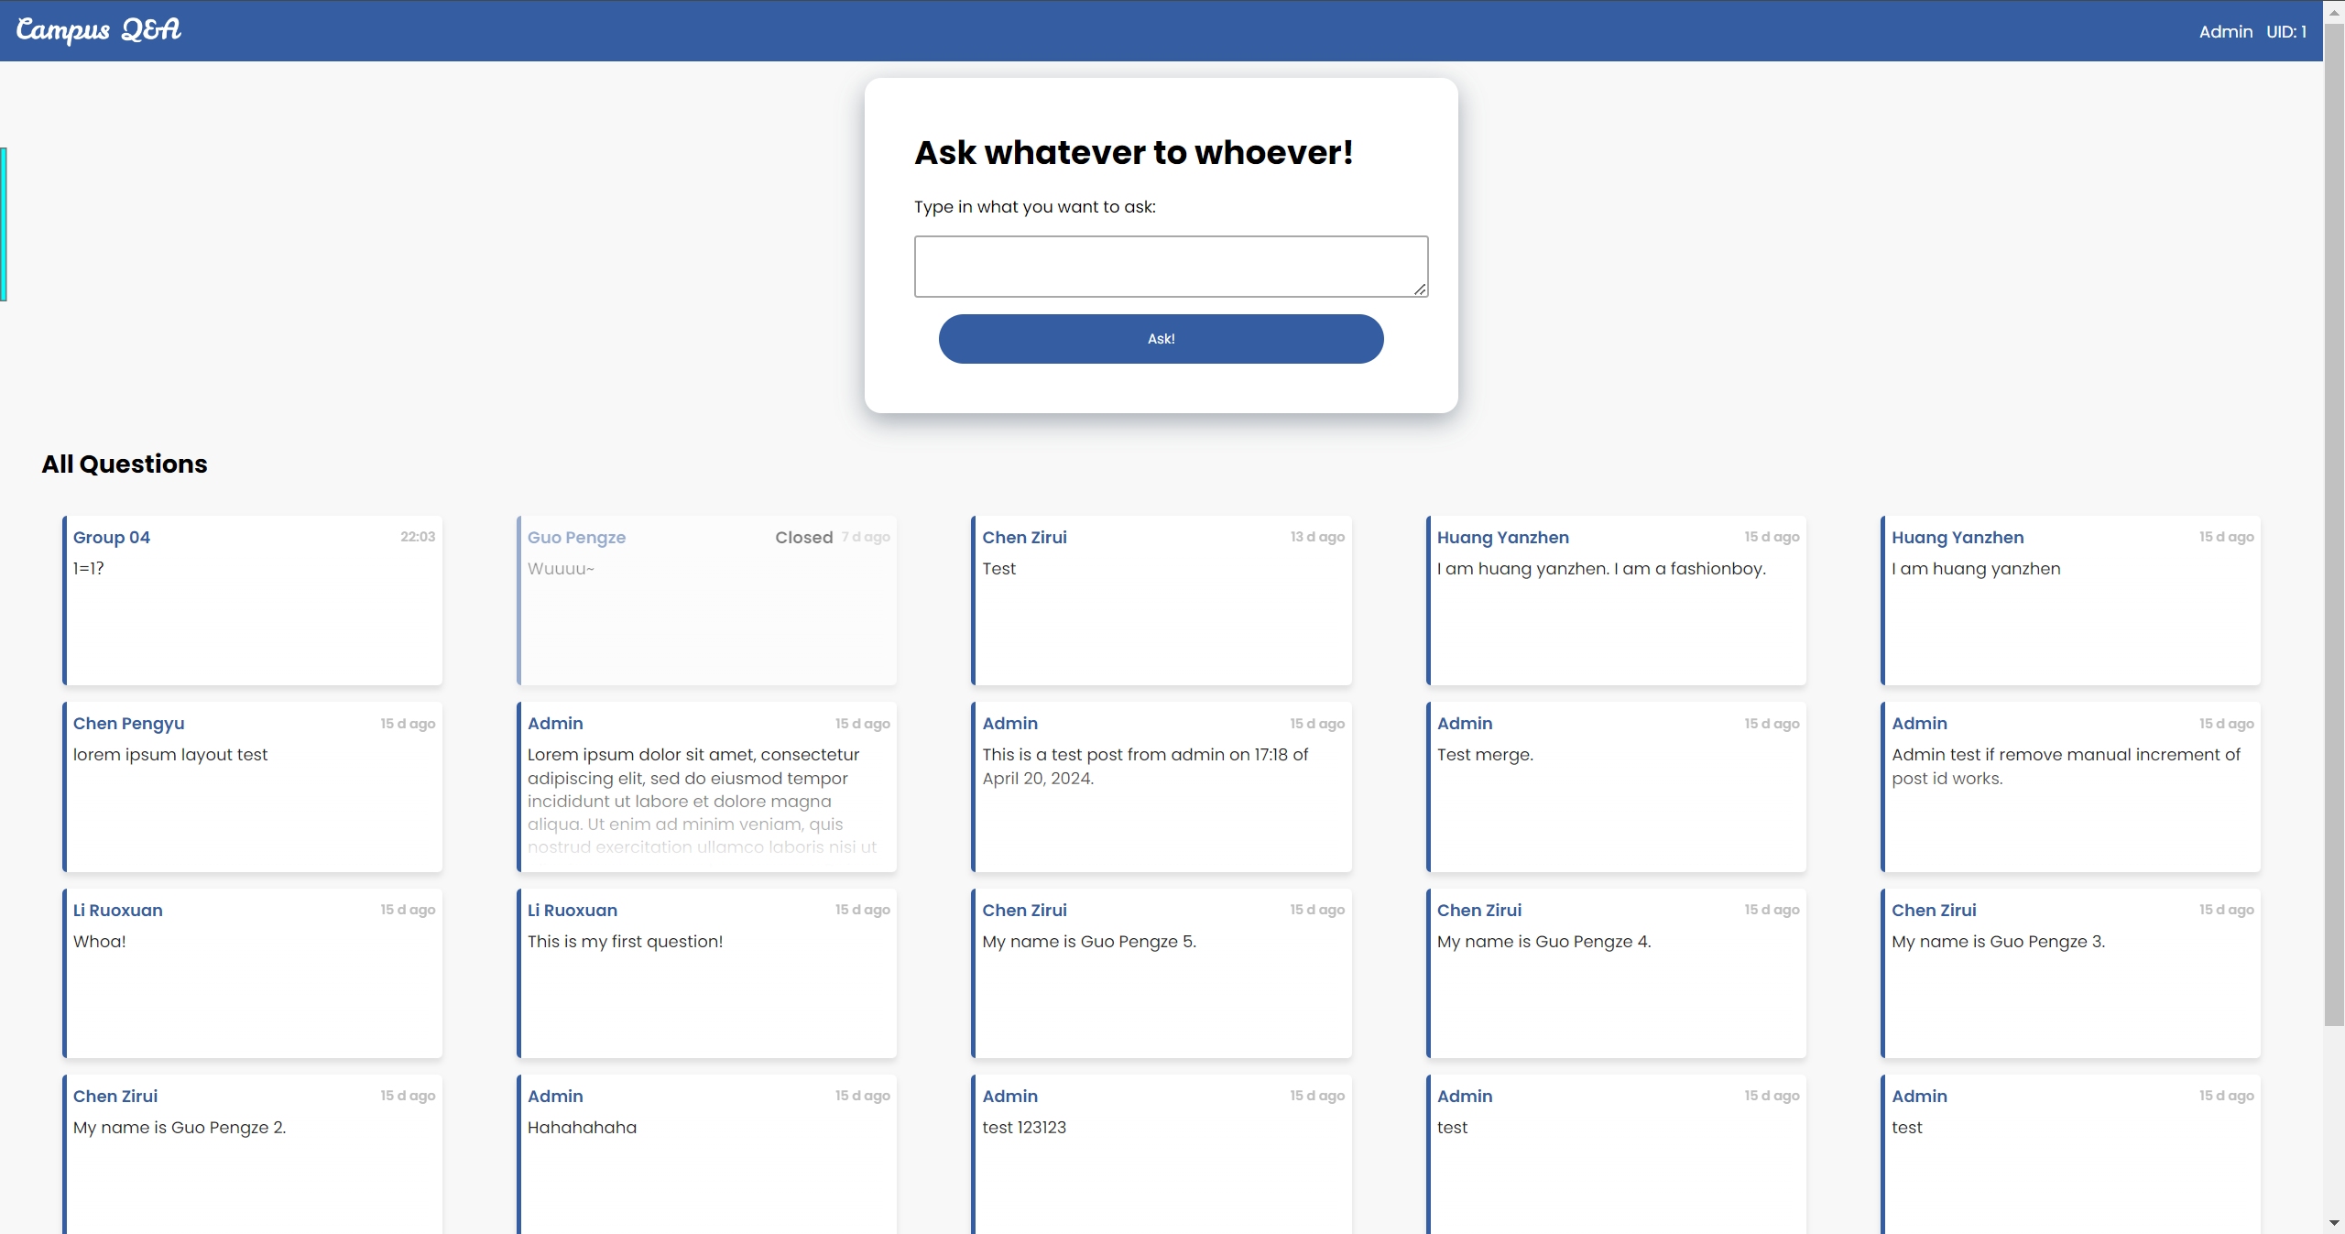
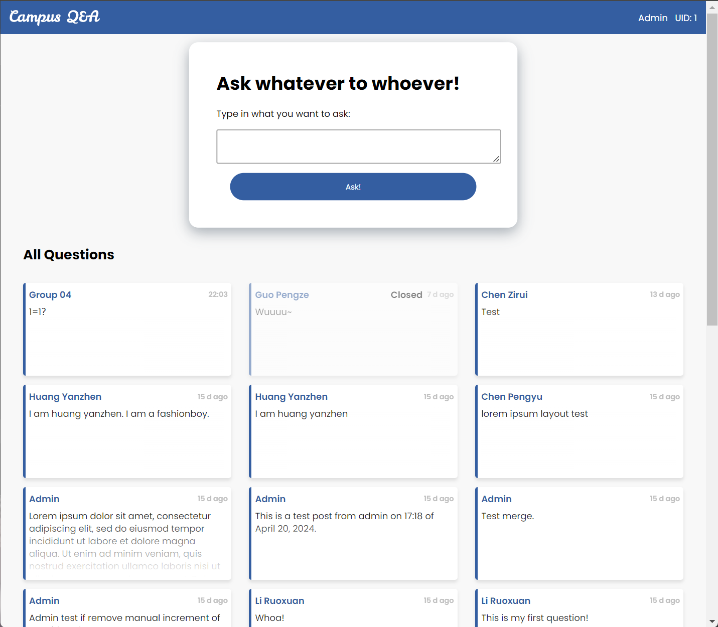
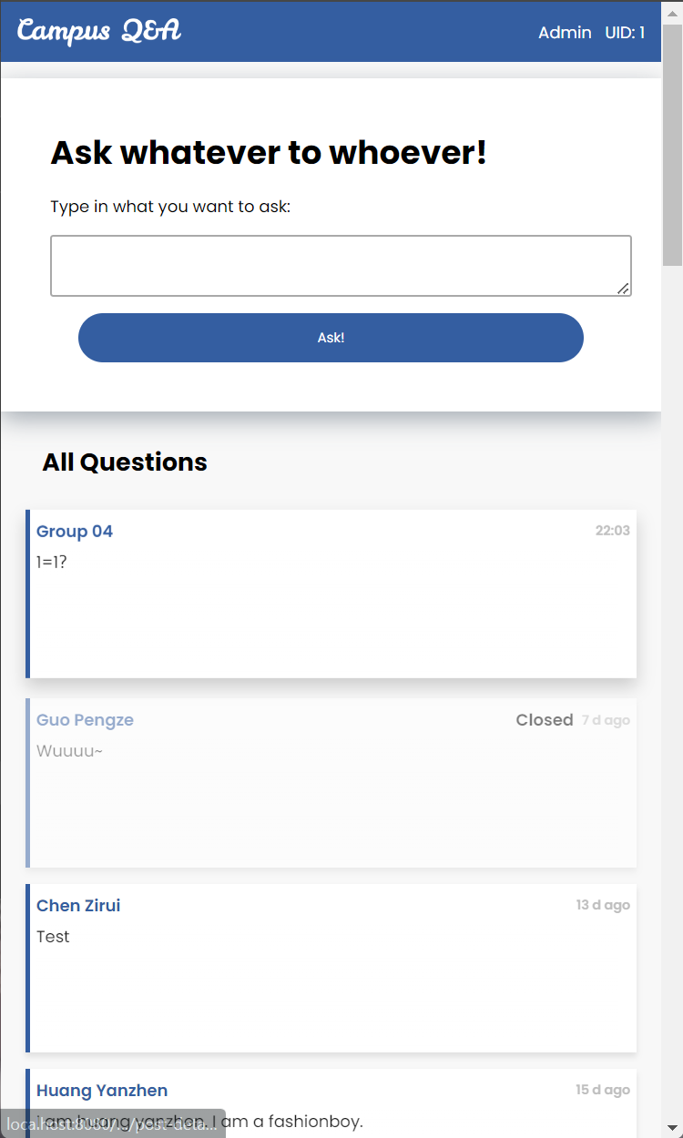
System Design / User Interface / Responsive
narrower
Even narrower

Slide 11
PART 03
Database Design

Slide 12
Thank you for listening!

